Slide 1

PRESENTATION ON UNDERSTANDING
THE JOB MARKET IN NIGERIA.
By Vivian Aiguedowan

Slide 2
Purpose of the study
The aim is to analyse job employment and unemployment rates in the Nigerian market.

Slide 3
Questions to Ponder On
What is the trend in Unemployment/Employment over the years?
Does gender play a crucial part in employment opportunity?
Does a course field influence employment opportunity?
Which year was increase in employment rates the highest?
Does the level of qualification influence the chances of employment?

Slide 4
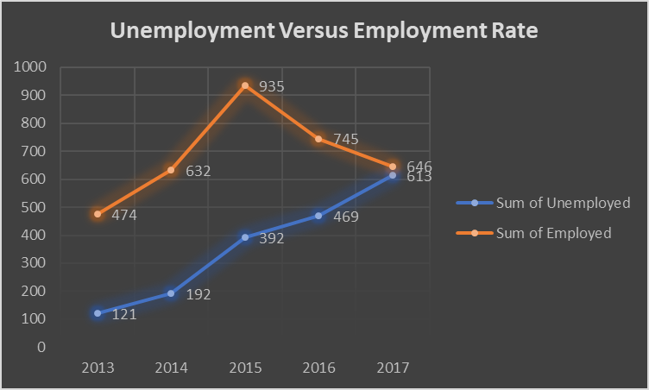
What is the trend in unemployment/ employment over the years

Slide 5
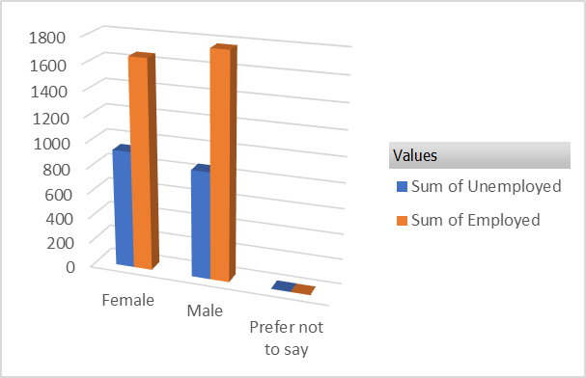
Does gender play a crucial part in employment opportunity?

Slide 6
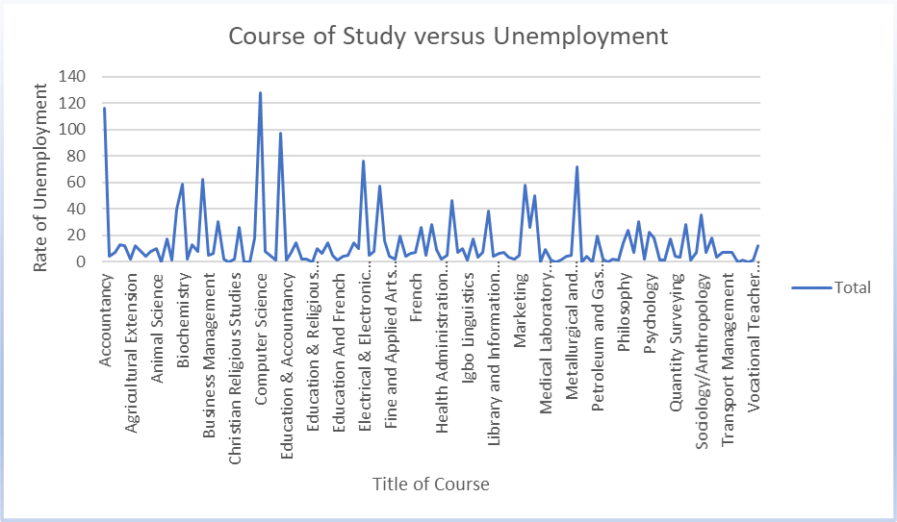
Does a course field influence unemployment opportunity?

Slide 7
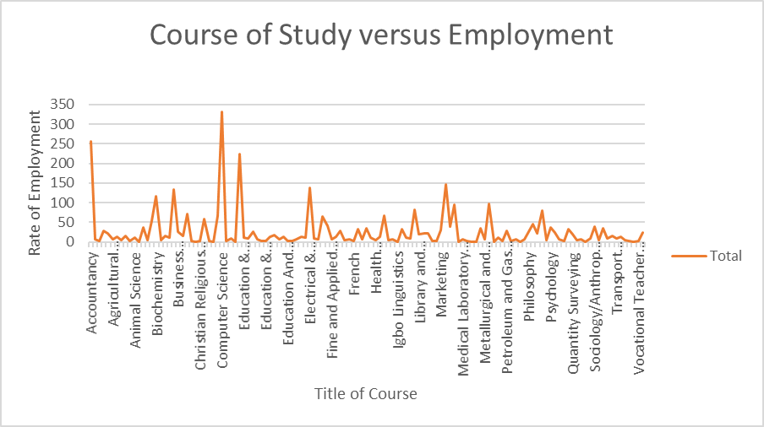
Does a course field influence employment opportunity?

Slide 9
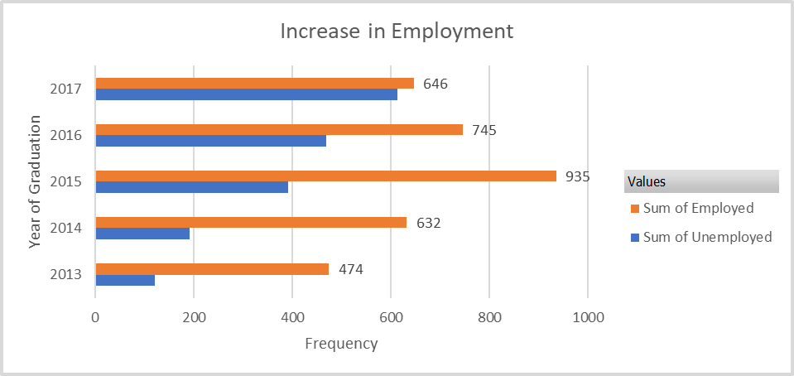
Which year was increase in employment rates the highest?

Slide 10
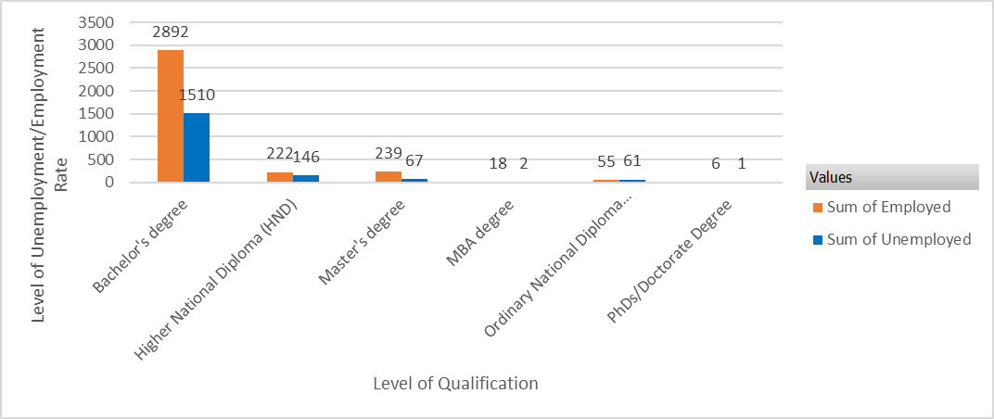
Does the level of qualification influence the chances of employment?

Slide 11
Conclusion
The year 2015 has the highest employment rates with computer science giving the highest course with high job opportunity. while 2013 had the lowest rate of job openings.
All through the years analysed, employment rate has been higher favouring the male gender than unemployment rate though the latter continues to rise every year.
Opportunity for employment increases with educational qualifications of job seekers.

Slide 12
Recommendations
Job opportunities should be created and aligned for specific educational background and experience to ensure the right candidates get the jobs.
Individuals should embrace skill diversity to help them get more equipped for better job roles especially in this computer age.

Slide 13


